Slide 1
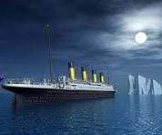
Titanic Survival Prediction: Machine Learning Modeling
Rohit Narwal
March 5th, 2026

Slide 2
The Hypothesis
Determining exactly which passengers had the most likely chance of survival.
The Machine Learning Task: Treat survival as a binary classification problem (0 = Did not survive, 1 = Survived).
The Dataset:
891 historical passenger records containing a mix of:
Demographics: Age, Sex
Socioeconomic Status: Ticket Class (Pclass), Fare Price
Family Details: Number of siblings, spouses, or parents onboard.

Slide 3
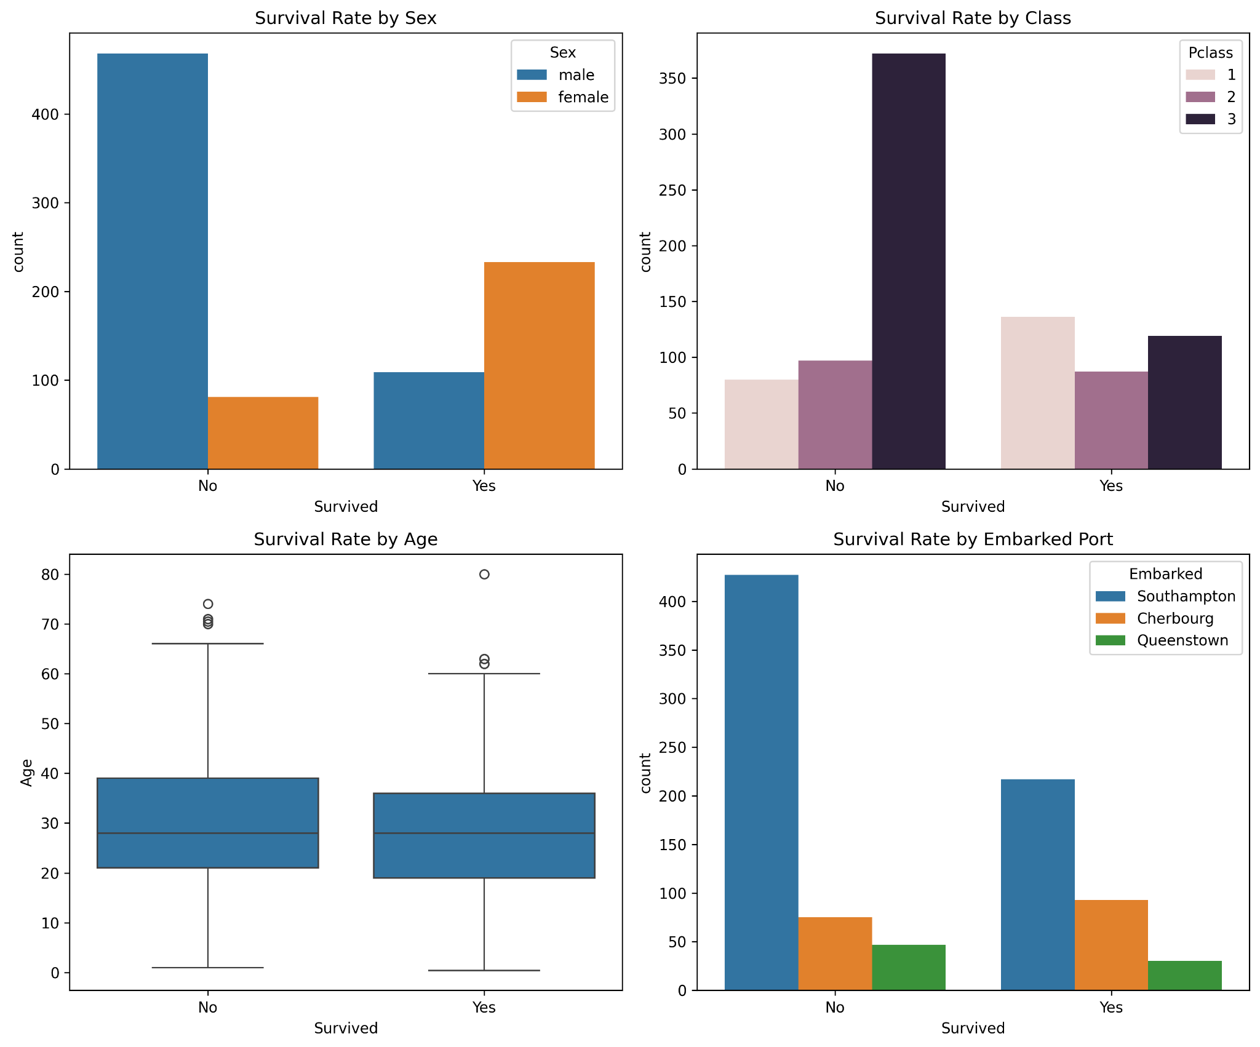
Who Survived?
Females had a drastically higher survival rate than males.
1st Class passengers were much more likely to survive than 3rd Class.
Titles like "Mrs" and "Miss" survived at higher rates than "Mr".

Slide 4
Preparing the Data for Modeling
Extracted Title from passenger names to better estimate age and social status.
Combined Siblings/Spouses and Parents/Children to create FamilySize.
Created an IsAlone flag (passengers traveling solo).
Used a Scikit-Learn Pipeline to scale numerical data and prevent data leakage.

Slide 5
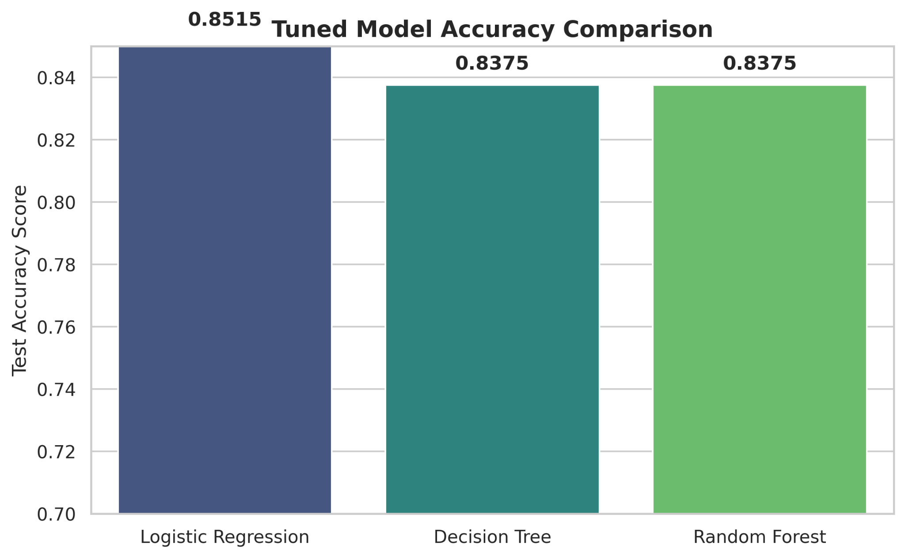
Choosing the Best Algorithm
Tested Logistic Regression, Decision Tree, and Random Forest.
Used GridSearchCV to tune hyperparameters (like max depth and number of trees).
Winner: Logistic Regression achieved the highest validation accuracy (~85%).

Slide 6
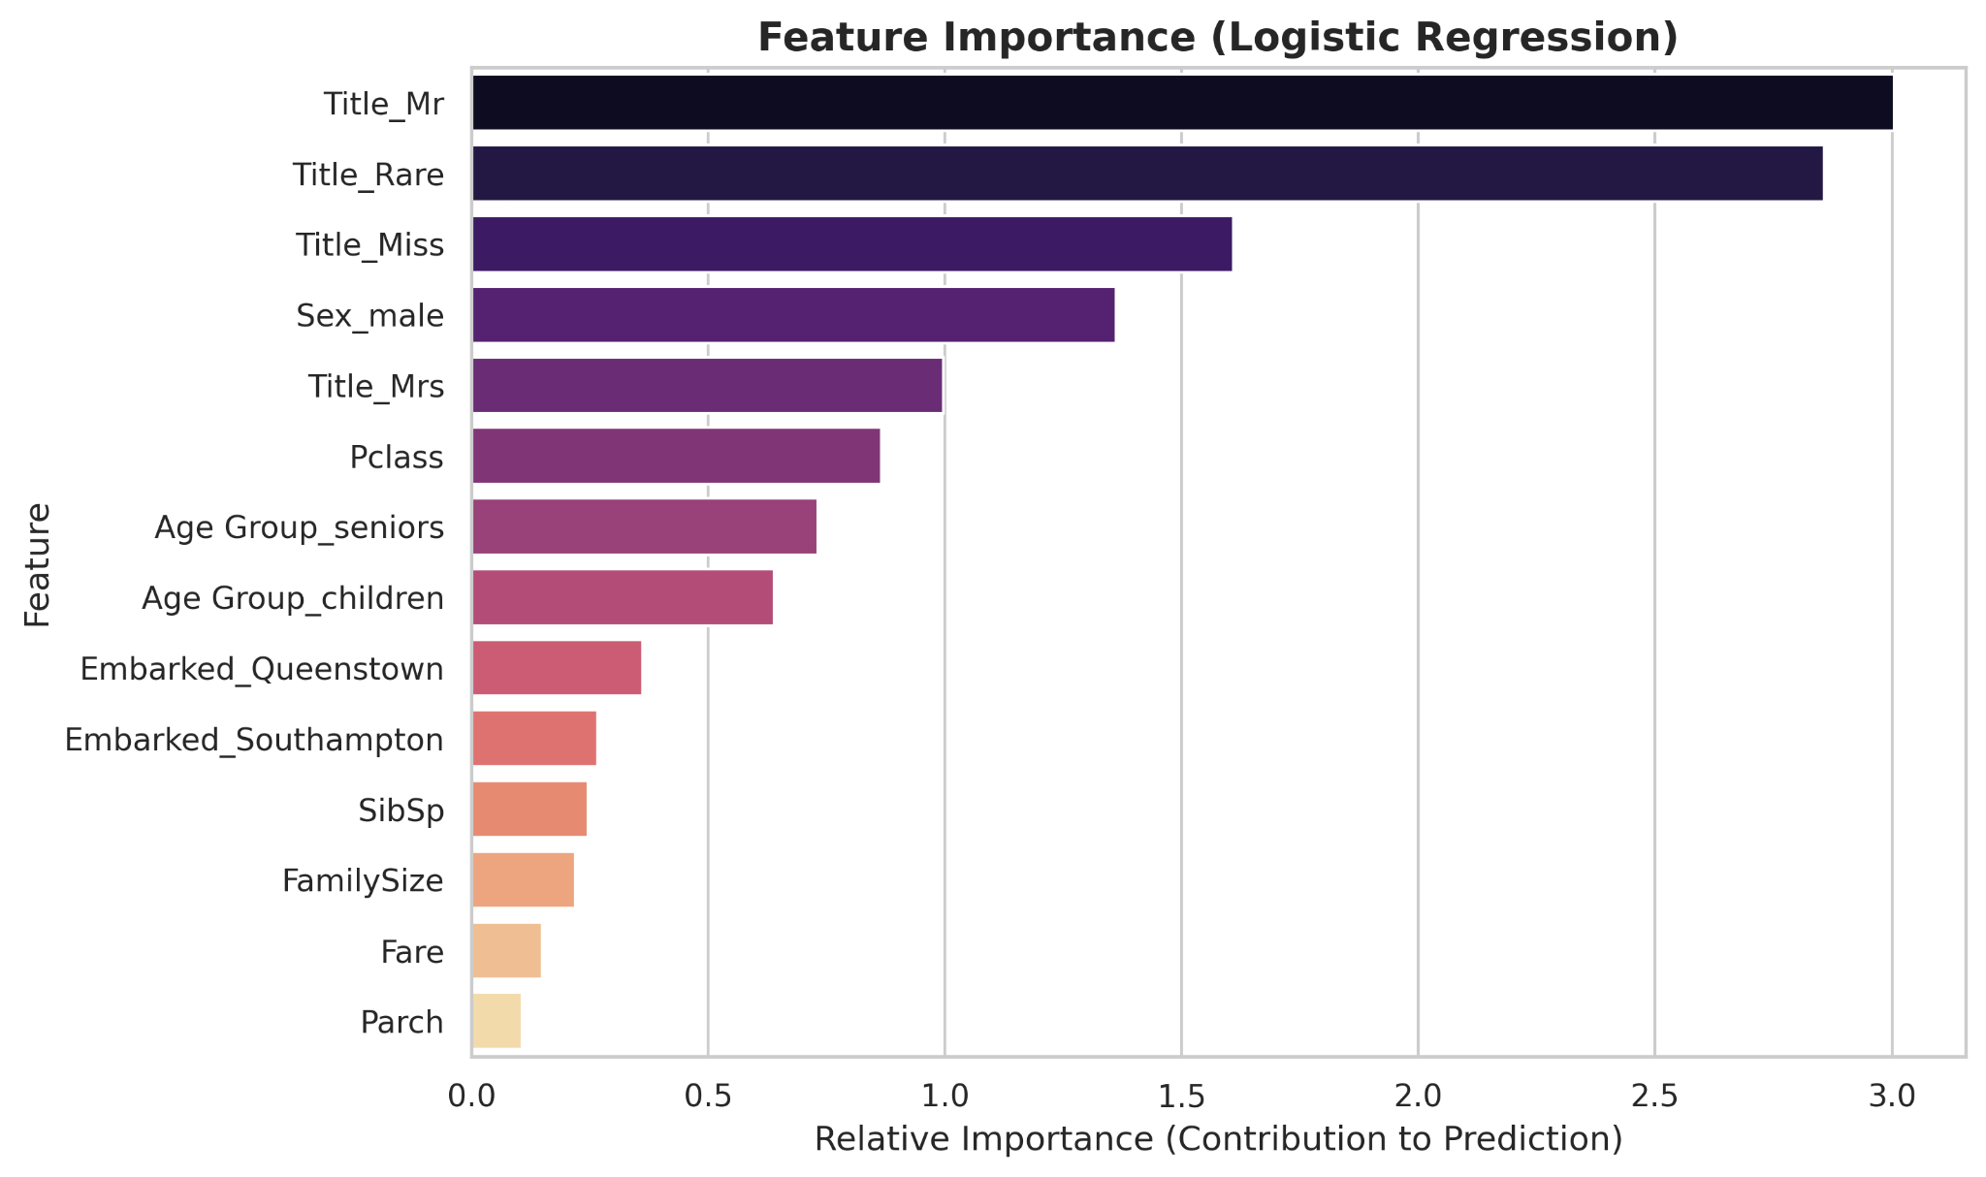
How Did the Model Decide?
The model relied heavily on Gender (Sex_male) and Ticket Price (Fare).
Age and Passenger Class were the next most critical factors.
Family size had a moderate impact on survival chances.

Slide 7
Results & Takeaways
Successfully predicted survival with 85% accuracy using Logistic Regression.
Learned the vital importance of preventing data leakage using Pipelines.
Proved that feature engineering (like extracting Titles) gives models a significant boost.
Applied Log-Transformation on Fare to reduce Skewness.

